Slide 1
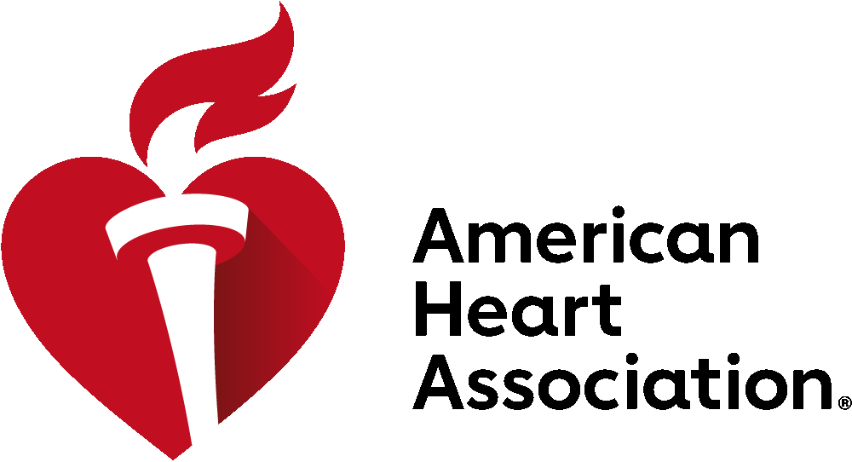
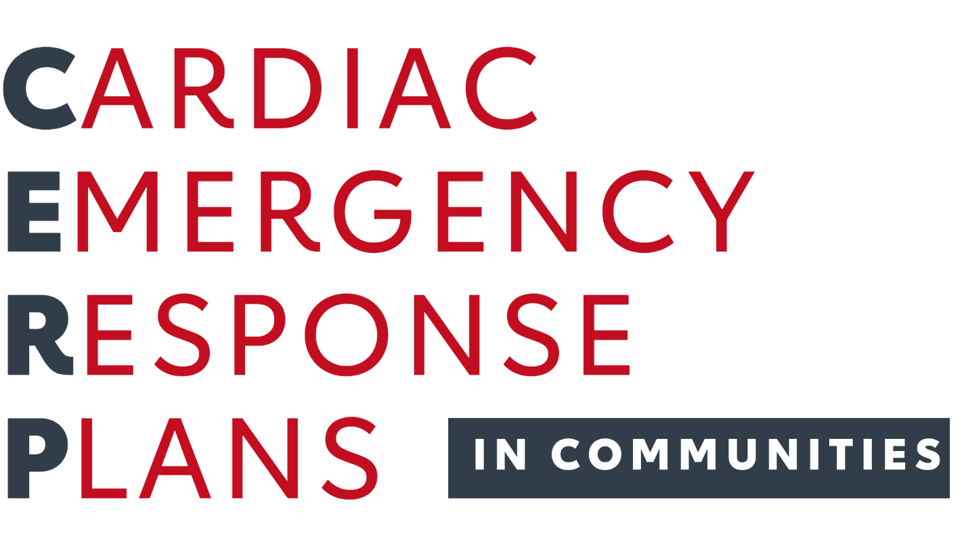
Empowering a Nation of Lifesavers™

Slide 2
What is Sudden Cardiac Arrest?
Sudden cardiac arrest occurs when the heart malfunctions and stops beating unexpectedly.
An electrical malfunction in the heart causes an arrhythmia, or irregular heartbeat.
In seconds, a person becomes unresponsive and cannot breathe.
Death occurs within minutes if the person does not receive treatment.

Slide 3
Cardiac Arrest Is a Leading Cause of Death
Cardiac arrest can happen anywhere, to anyone, at any age.
350,000+
CARDIAC ARRESTS occur outside of a hospital annually in the U.S.

Slide 4
Cardiac Arrest is a Health Equity Issue
Lack of CPR training and resources is a health equity issue.
WOMEN are less likely than a man to receive CPR from a bystander.
MEDIAN INCOME neighborhoods are less likely to survive cardiac arrest outside of the hospital.
BLACK & HISPANIC adults are substantially less likely to receive bystander CPR.

Slide 5
Cardiac Arrest in [COMMUNITY]
In [STATE, #] cardiac arrests occur outside of a hospital each year.
[Add more information or data points here].

Slide 6
Did You Know?
Cardiac arrest can be reversed if lifesaving care is administered within a few minutes.
CPR, if performed immediately, can DOUBLE OR TRIPLE a person’s chance of survival.

Slide 7
That's Where CERPs Come In
What is a CERP?
It’s a written document that establishes specific steps to reduce death from cardiac arrest in community settings and ensures that school responders are trained on how to execute them.
A CERP can be stand-alone guidelines or merged with existing response plans.

Slide 8
CERPs Save Lives!
CERPs more than DOUBLE survival rates from cardiac arrest by empowering people to take action and dial 911, start CPR, and use an AED.
We need CERPs in every community organization, school and athletic facility.
CERPs should also be integrated into a community's local EMS responder protocols.

Slide 9
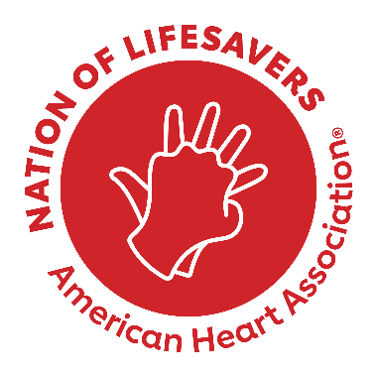
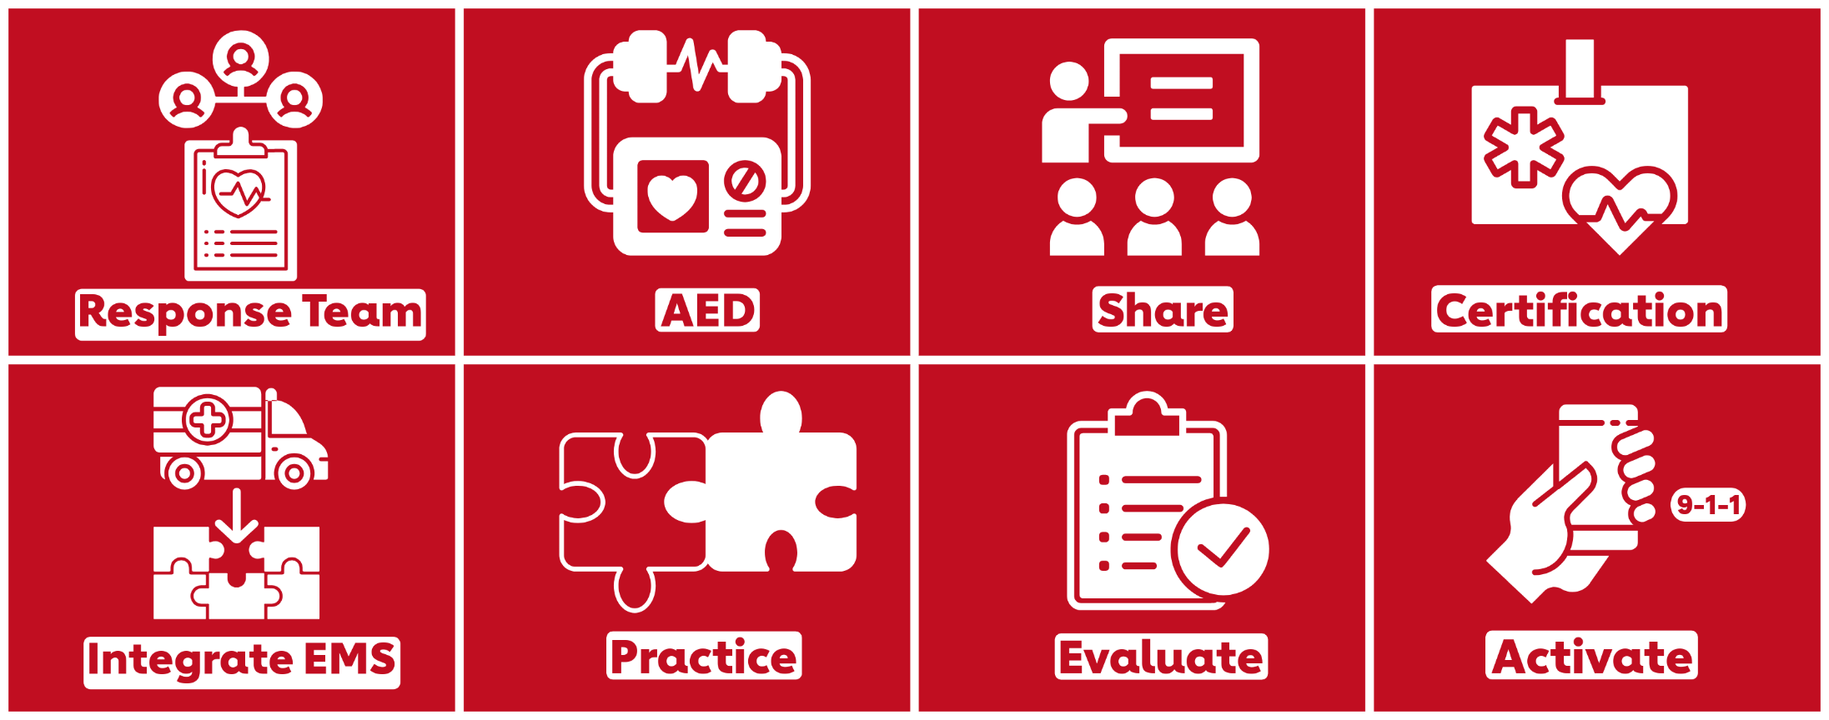
Elements of a CERP
Following the evidence-based core elements will ensure proper preparation, response, and evaluation.

Slide 10
Help Us Build a Nation of Lifesavers™
The American Heart Association is committed to turning a nation of bystanders into a Nation of Lifesavers™, so that in the face of a cardiac emergency, anyone, anywhere is prepared and empowered to perform CPR and become a vital link in the Chain of Survival.

Slide 11
Join the Nation of Lifesavers™
Be a part of the movement to
double survival rates from sudden
cardiac arrest by 2030.
Visit heart.org/nation

Slide 12
[Add custom call to action here]
Together, we can double the survival rate from cardiac arrest by 2030.
[Add a little bit of body text].

